Slide 1
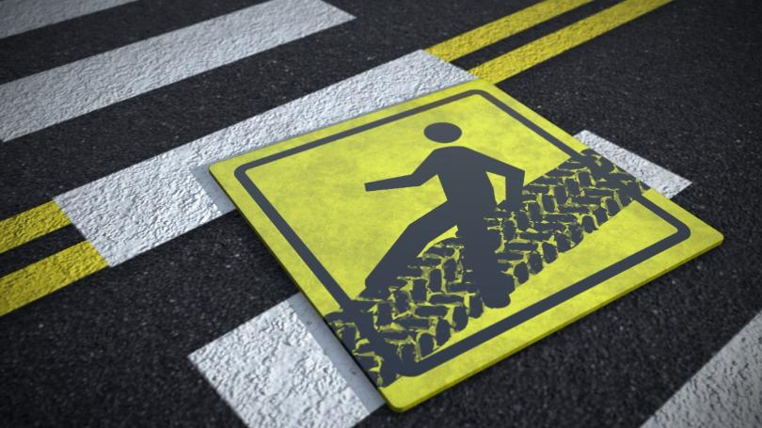
The Pittsburgh LEFT has no RIGHT.
How we can help raise awareness to pedestrian and cyclist safety around the city
IXD II | Section B | Assignment 4
Huayun Huang, Ross Rybalov, Sarah Papp

Slide 2
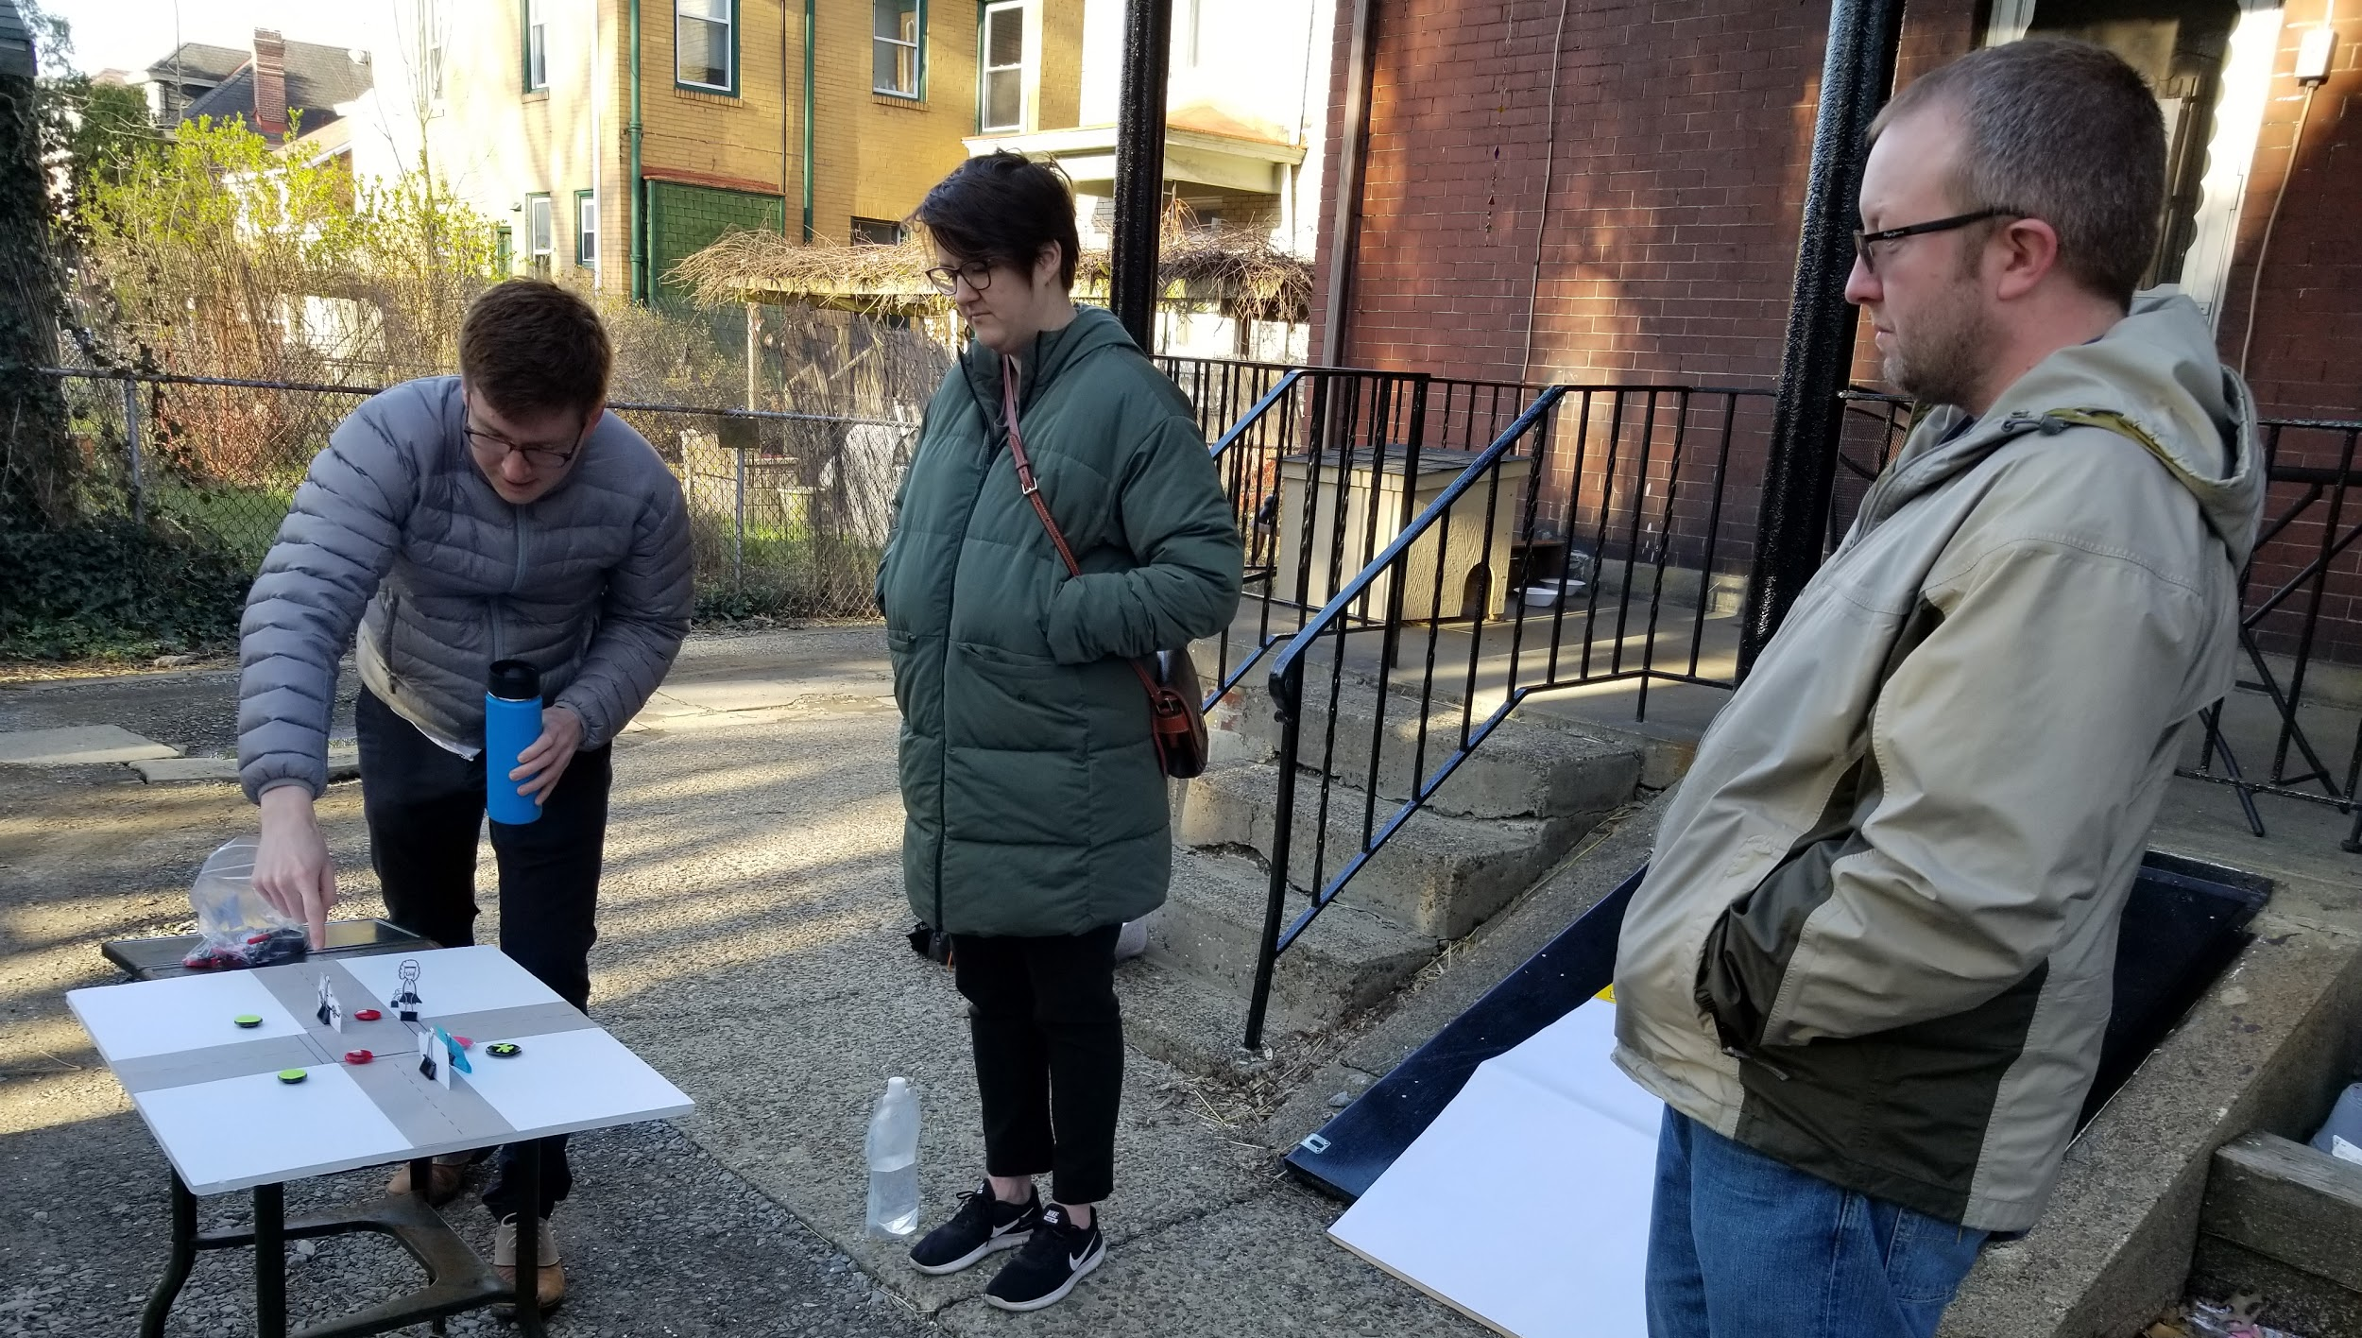
Thank you to our participants
Thank you
Problem review
We want to thank you for sharing those moments of almost getting hit by cars in intersections and almost running over pedestrians. This could not have been easy.
Co-design recap
Solution
How you can help
Notes:
We all have

Slide 3
Thank you to our participants
Thank you
Problem review
Drivers
Pedestrians
Cyclists
Pittsburgh Bike Coalition
Co-design recap
Solution
How you can help
Notes:
We have this group of people working together towards this goal… have drivers, pedestrians, cyclists
THank you for your diverse opinion, and the in depth

Slide 4
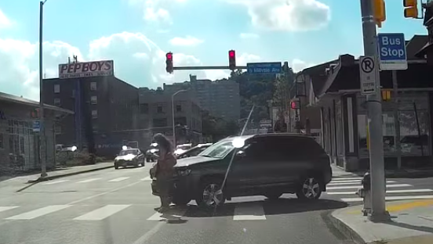
Problem review
Thank you
Problem review
The Pittsburgh Left is a cultural tradition where the first left-turning vehicle takes precedence over vehicles going straight through an intersection.
Co-design recap
Solution
How you can help

Slide 5
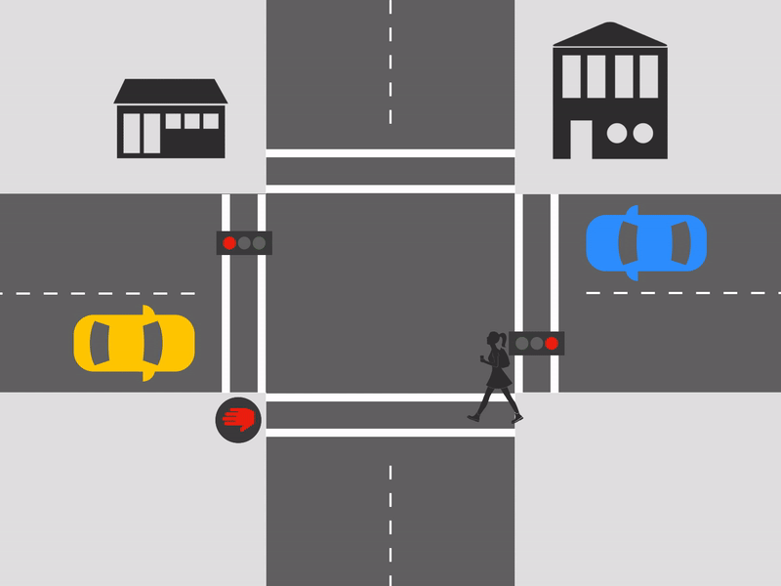
Example
Thank you
Problem review
Co-design recap
Solution
How you can help

Slide 6
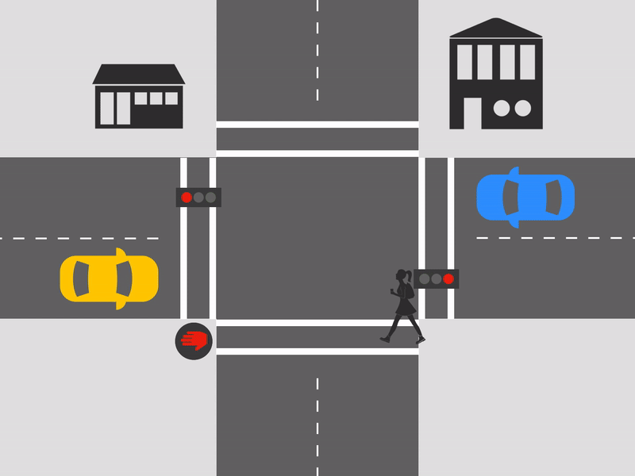
Example
Thank you
Problem review
Co-design recap
Solution
How you can help

Slide 7
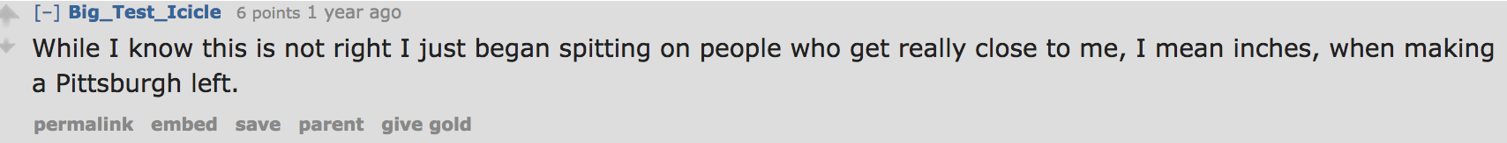
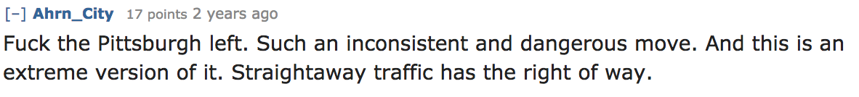
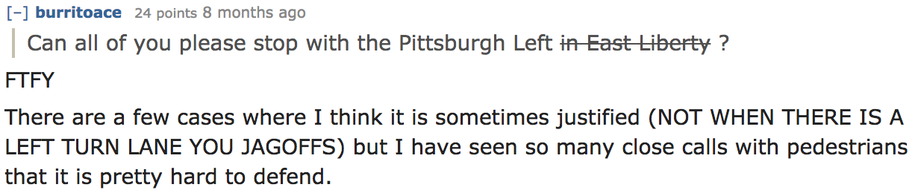
Online response
Thank you
Problem review
Co-design recap
Solution
How you can help

Slide 8
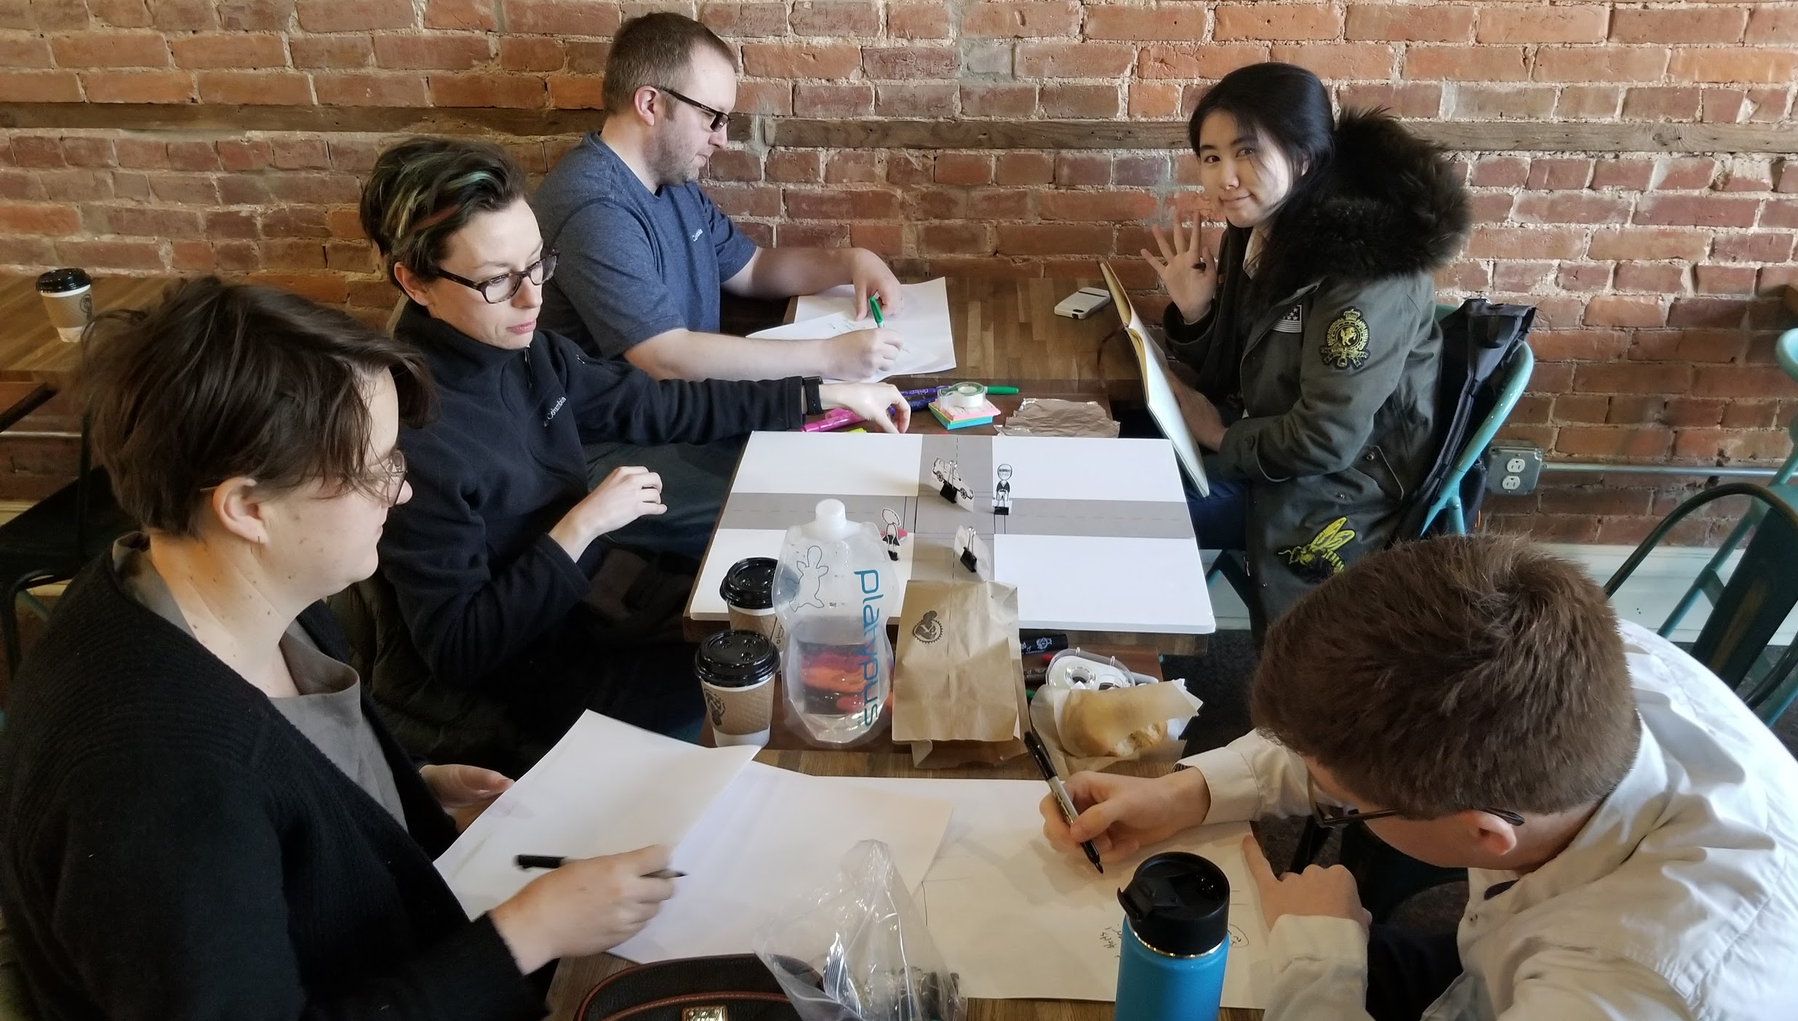
Co-design recap
Thank you
Problem review
Participatory design sessions with pedestrians, bikers, and drivers
Instrument social change
Add to conversation at the city level
Co-design recap
Solution
How you can help
Notes:
Participatory design sessions with pedestrians, bikers, and drivers
Your most recent experience with the Pittsburgh left and how that made you feel
Helped each other figure out most pressing Issues with the Pittsburgh Left
Identify most problematic intersections
Brainstorm solutions that could be implemented
Originally we had scoped your co-design sessions to focus on something we can implement at intersection
Through your dialogue - Instrument social change
Add to conversation at the city level

Slide 9
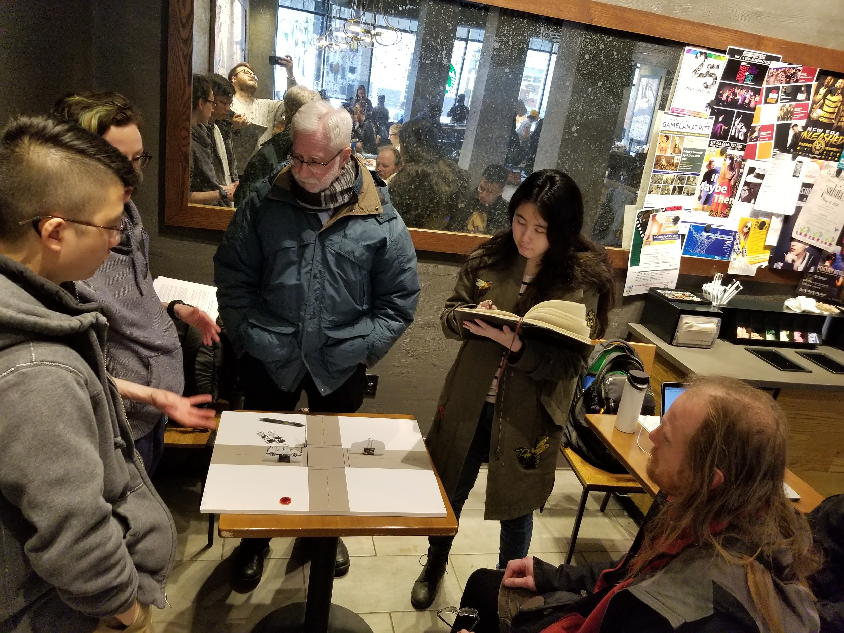
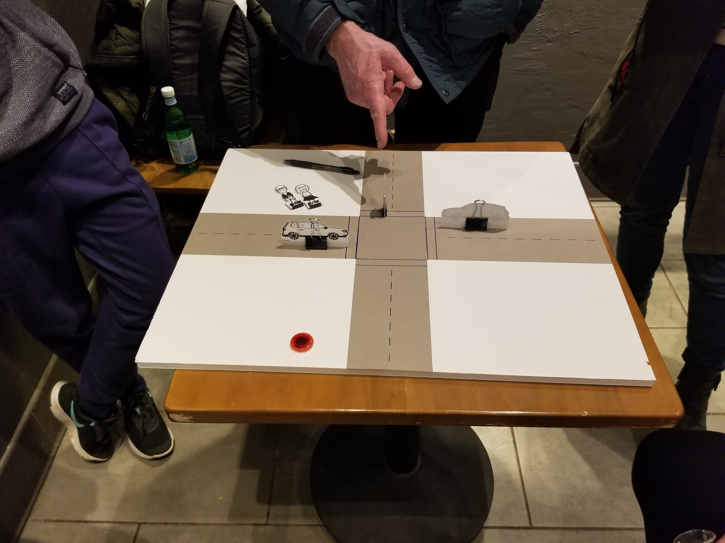
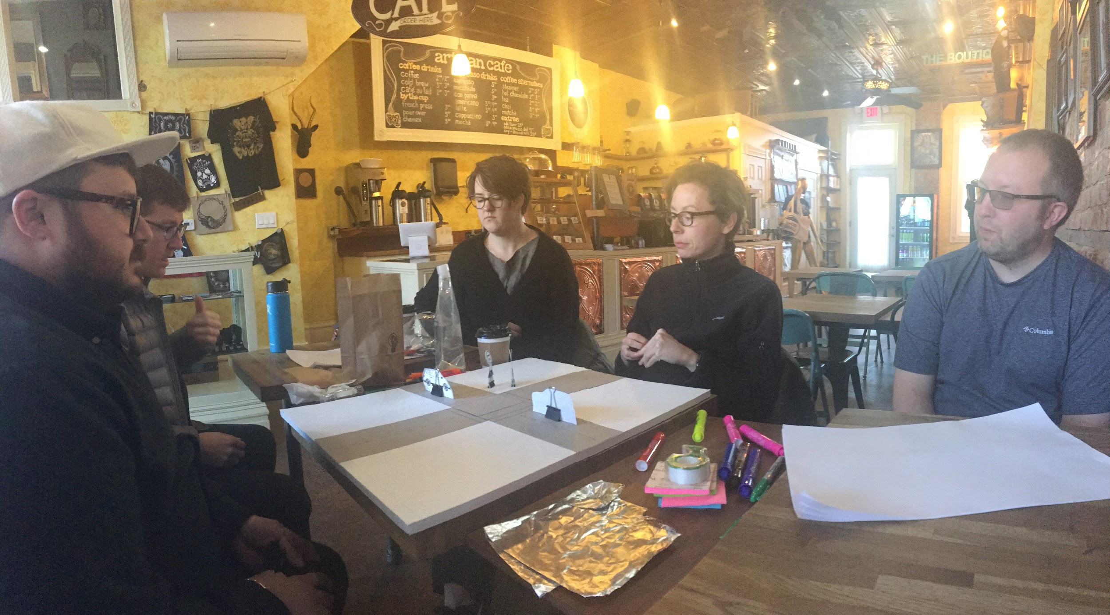
Co-design recap
Thank you
Problem review
Co-design recap
Solution
How you can help
Notes:
The question then became, how might we address a social problem on this local level?
Through your conversations, activities, and brainstorming you came up with an ingenious social solution
[NEXT] Solution

Slide 10


Solution
Thank you
Addressing the social problem:
Community moderated social media channels
Post and promote crowd-sourced videos and images of safety issues associated with the Pittsburgh left
Problem review
How we got here
Solution
How you can help
#PGHleftisntright
@PGHleftness
@PGHleft
Notes:
Community moderated social media channels
That Post and promote crowd-sourced videos and images of safety issues associated with the Pittsburgh left
To bring your solution to life, the CMU team has created a Twitter, Youtube channel, and hashtag
Tool for the public to use to create change within Pittsburgh.
Hope that people will start to send us Videos from dash cams and camera phones

Slide 11
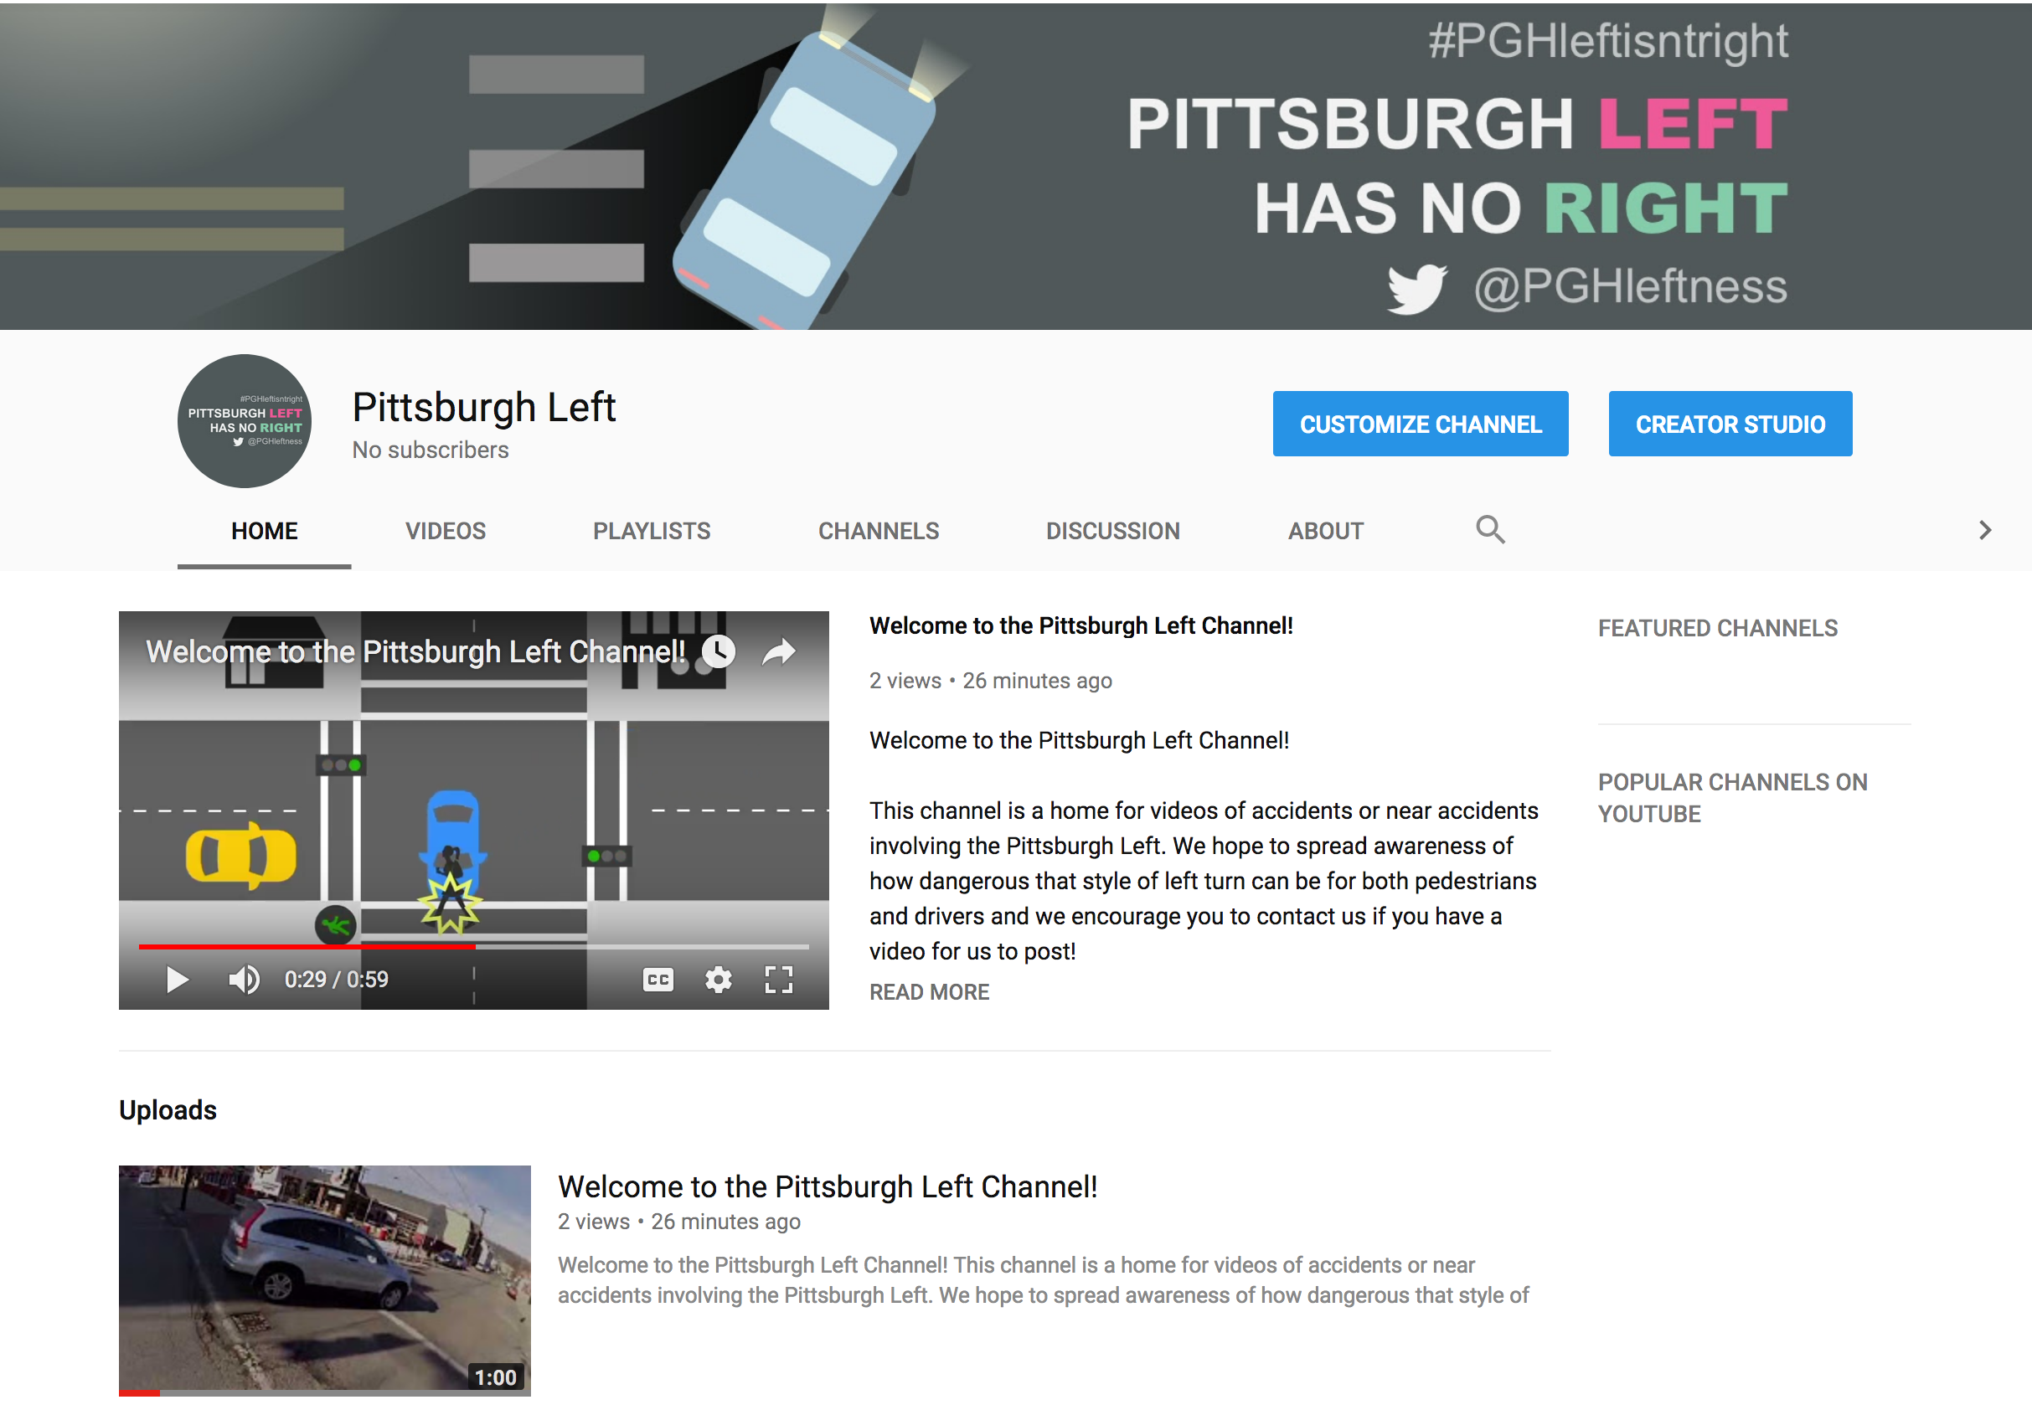
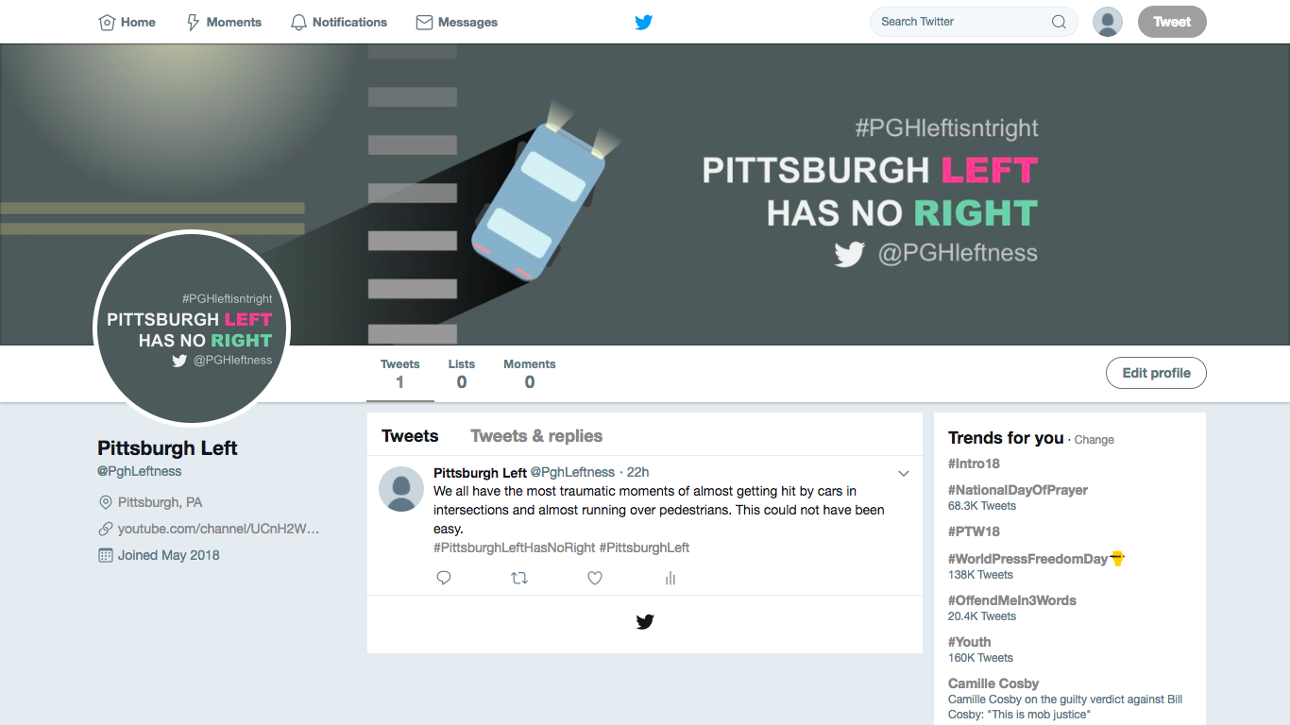
Solution
Thank you
Problem review
How we got here
Solution
How you can help

Slide 12
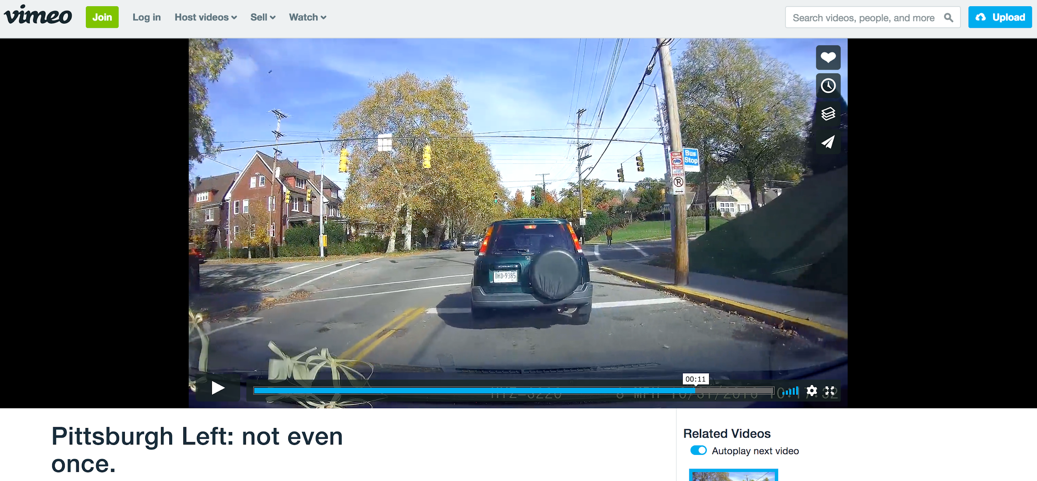
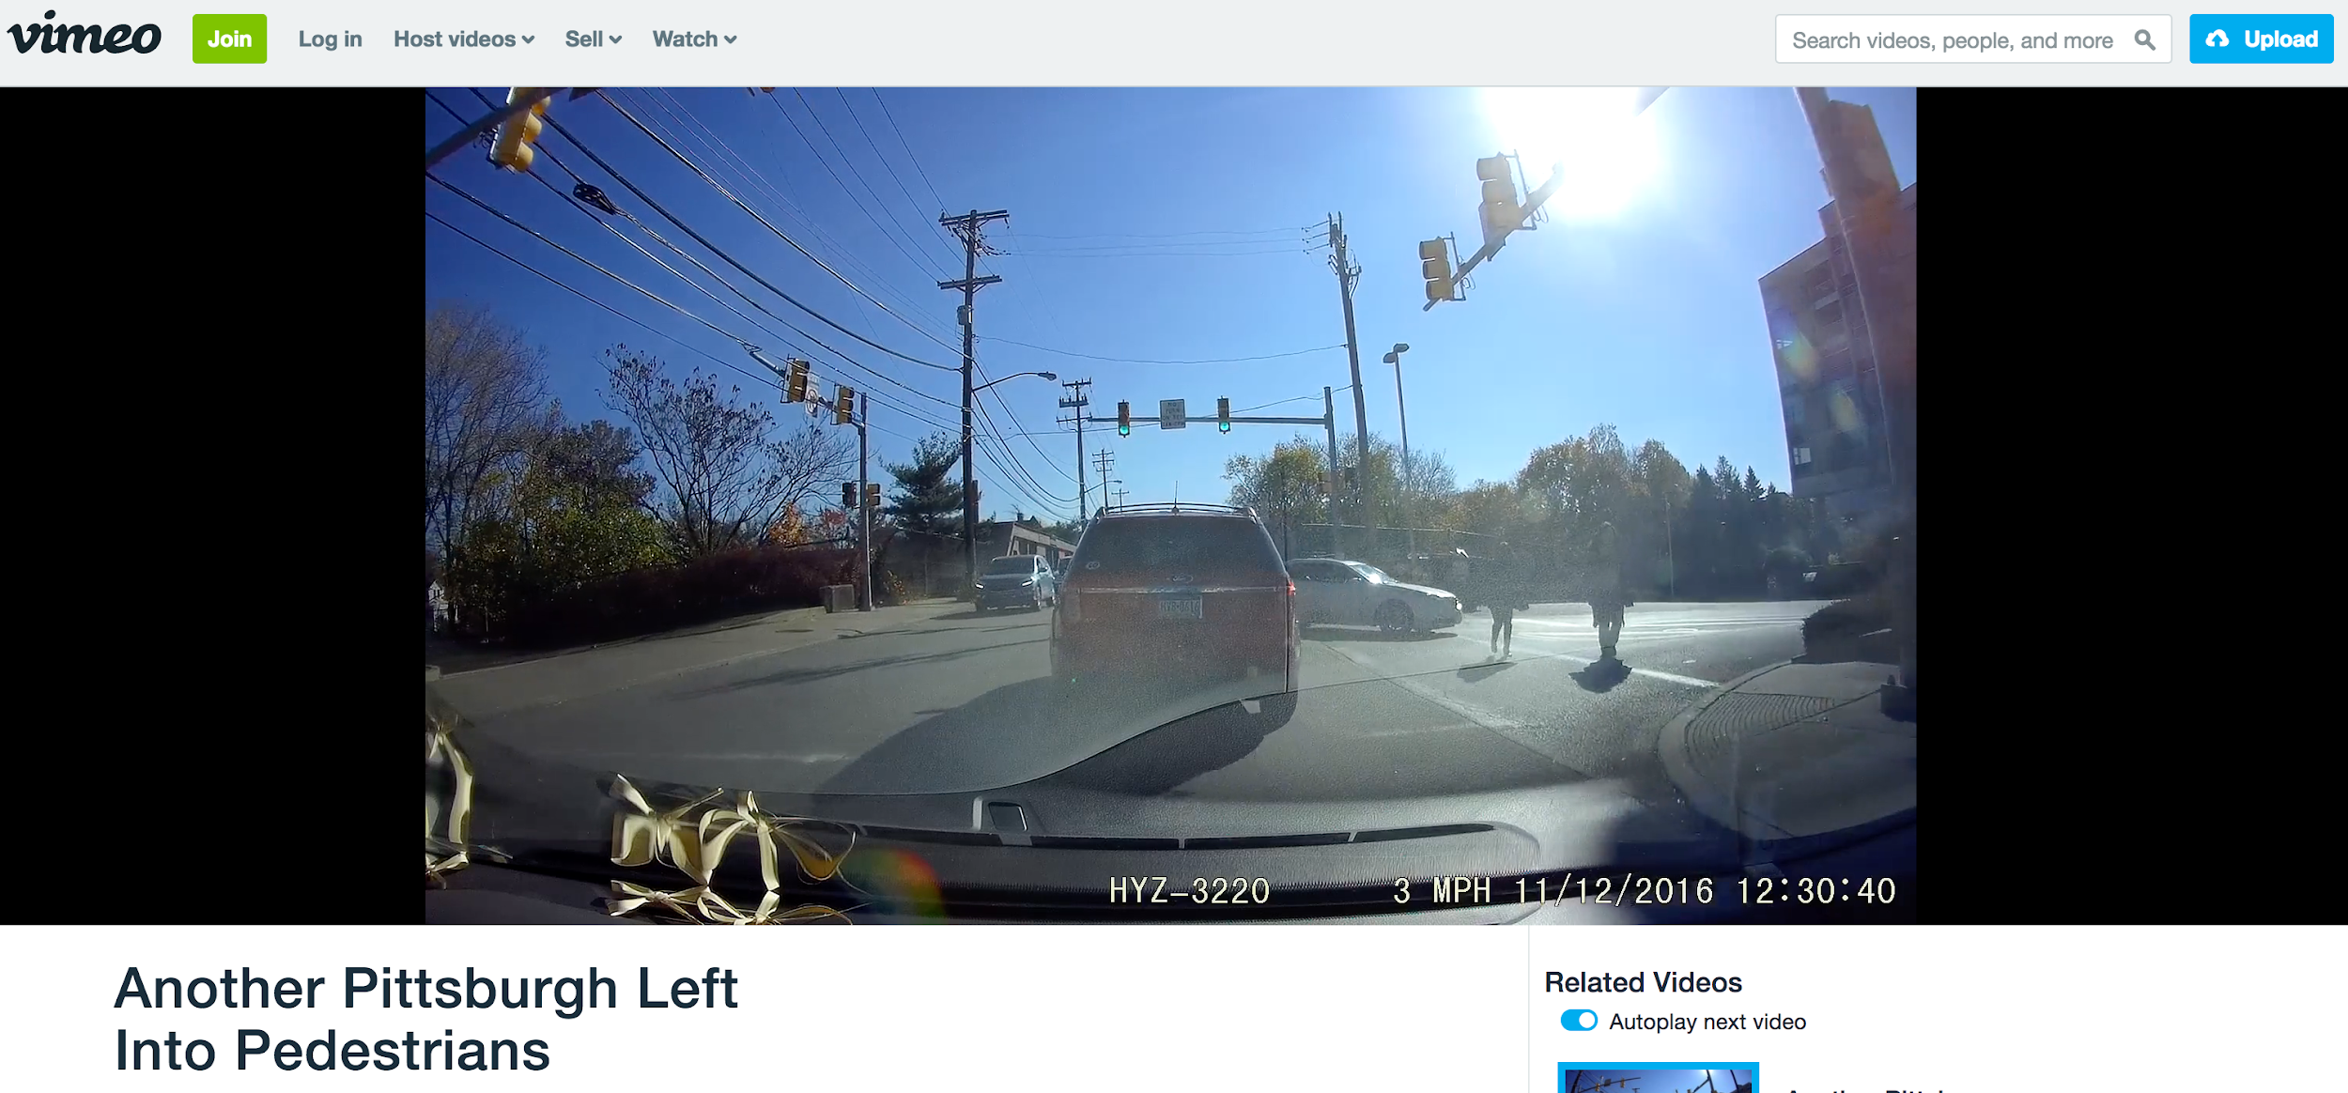
Solution
Thank you
Addressing the social problem:
Grassroots efforts raising awareness of how common the dangerous Pittsburgh Left can be
Using guilt and shame to make drivers realize the affect their actions have on others
Problem review
How we got here
Solution
How you can help
Notes:
What can be facilitated?
Grassroots efforts to raise awareness of how dangerous that style of left turn can be
Both pedestrians and drivers
As this gains awareness - guilt and shame make drivers realize the affect their actions have on others

Slide 13
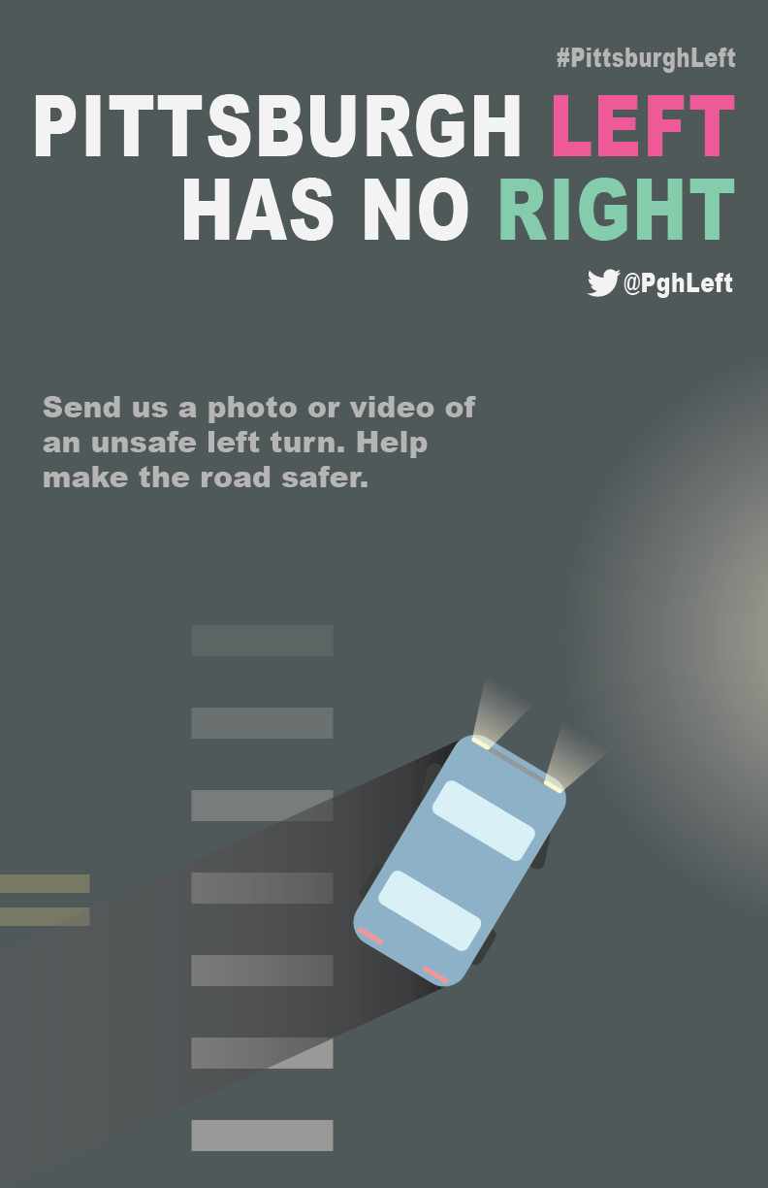
Solution
Thank you
Campaign Awareness and Change:
Posters at Intersections: Poster template that can be printed out by anyone and placed at the most problematic intersections.
Problem review
How we got here
Solution
How you can help
Notes:
Raise awareness about this new campaign
Poster template that anyone can print at home and place at the intersections they find to be most problematic in Pittsburgh

Slide 14
Solution
Thank you
Social Outcome: As the movement gains steam, we hope that it inspires safer driving, more alert pedestrians, and eventually a local cultural shift away from the acceptance of this custom to a more pedestrian friendly adherence to state law.
Problem review
How we got here
Solution
How you can help
Notes:
The community will be able to send the campaign of videos around to their councilmembers and neighborhood and other community organizations to foster the change that they want in their community.
As the movement gains steam, we hope that it inspires safer driving, more alert pedestrians, and eventually a local cultural shift away from the acceptance of this custom to a more pedestrian friendly adherence to state law.

Slide 15
How you can help now
Thank you
Take a poster
Post it at a dangerous intersection
Leave your email address with us
Problem review
How we got here
Solution
How you can help
Notes:
Take a poster
Post it
Leave your address so that we can add you to our channel as community managers.

Slide 16
How you can help in the future
Thank you
Take a video
Post a video
Share a video
Problem review
How we got here
Solution
How you can help
Notes:
Take a video
Post it
Share it

Slide 17
How you can help in the future
Thank you
We need you to become the ambassadors of this project
Moderate the social media channels
Continue to print up the poster and post in the most problematic intersections
Spread the word
Problem review
How we got here
Solution
How you can help
Notes:
How you can help in the future

Slide 18
Thank you
Thank you
Problem review
How we got here
#PGHleftisntright
@PGHleftness
@PGHleft
Solution
How you can help

